Slide 1
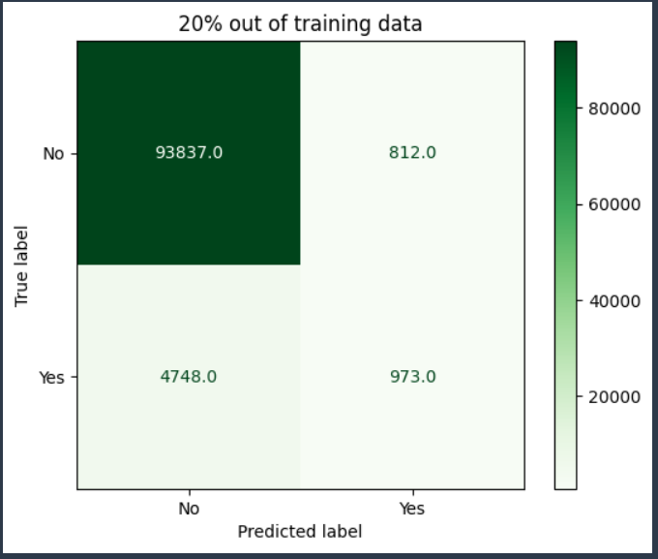
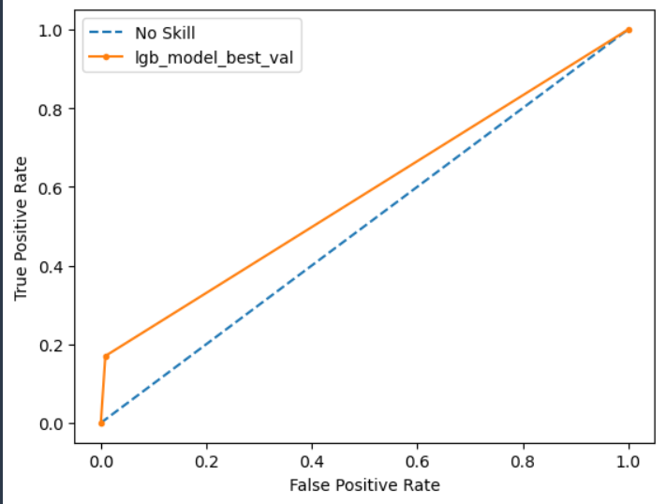
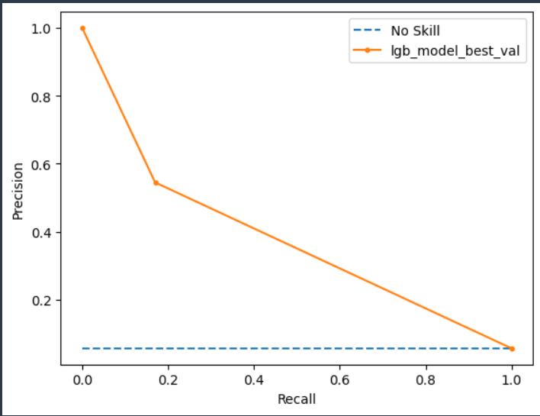
MSK Chronic Back NO Surgery performance report – balanced-VaL data
Algorithm selected = Light Boost
Threshold = 0.29
Recall = 17
Precision = 55
Accuracy = 94
AUC = 58
AUCPR = 38
F1 = 26
Confusion Matrix
ROC curve
Precision-Recall Curve

Slide 2
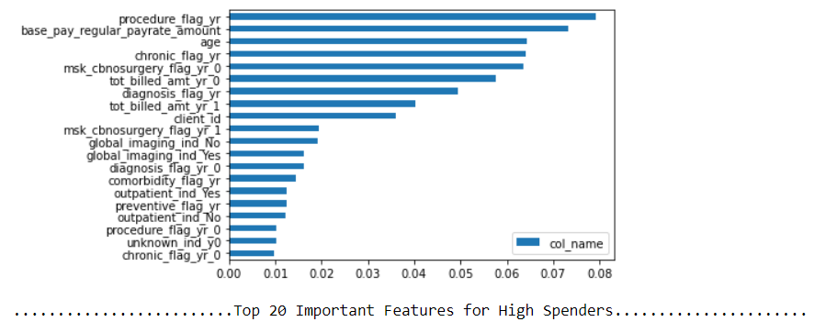
MSK Chronic Back No Surgery– feature importance-Balanced
Using claims and demographic data as predictors/features
Predicting the likelihood of customer go for MSK Chronic Back NO Surgery
Feature Importance using Model

